Slide 1
Horizon Europe project MIBIREM - Innovative Toolbox for Microbiome-based Soil Remediation
Name:
Affiliation:
Date:
Event:

Slide 2
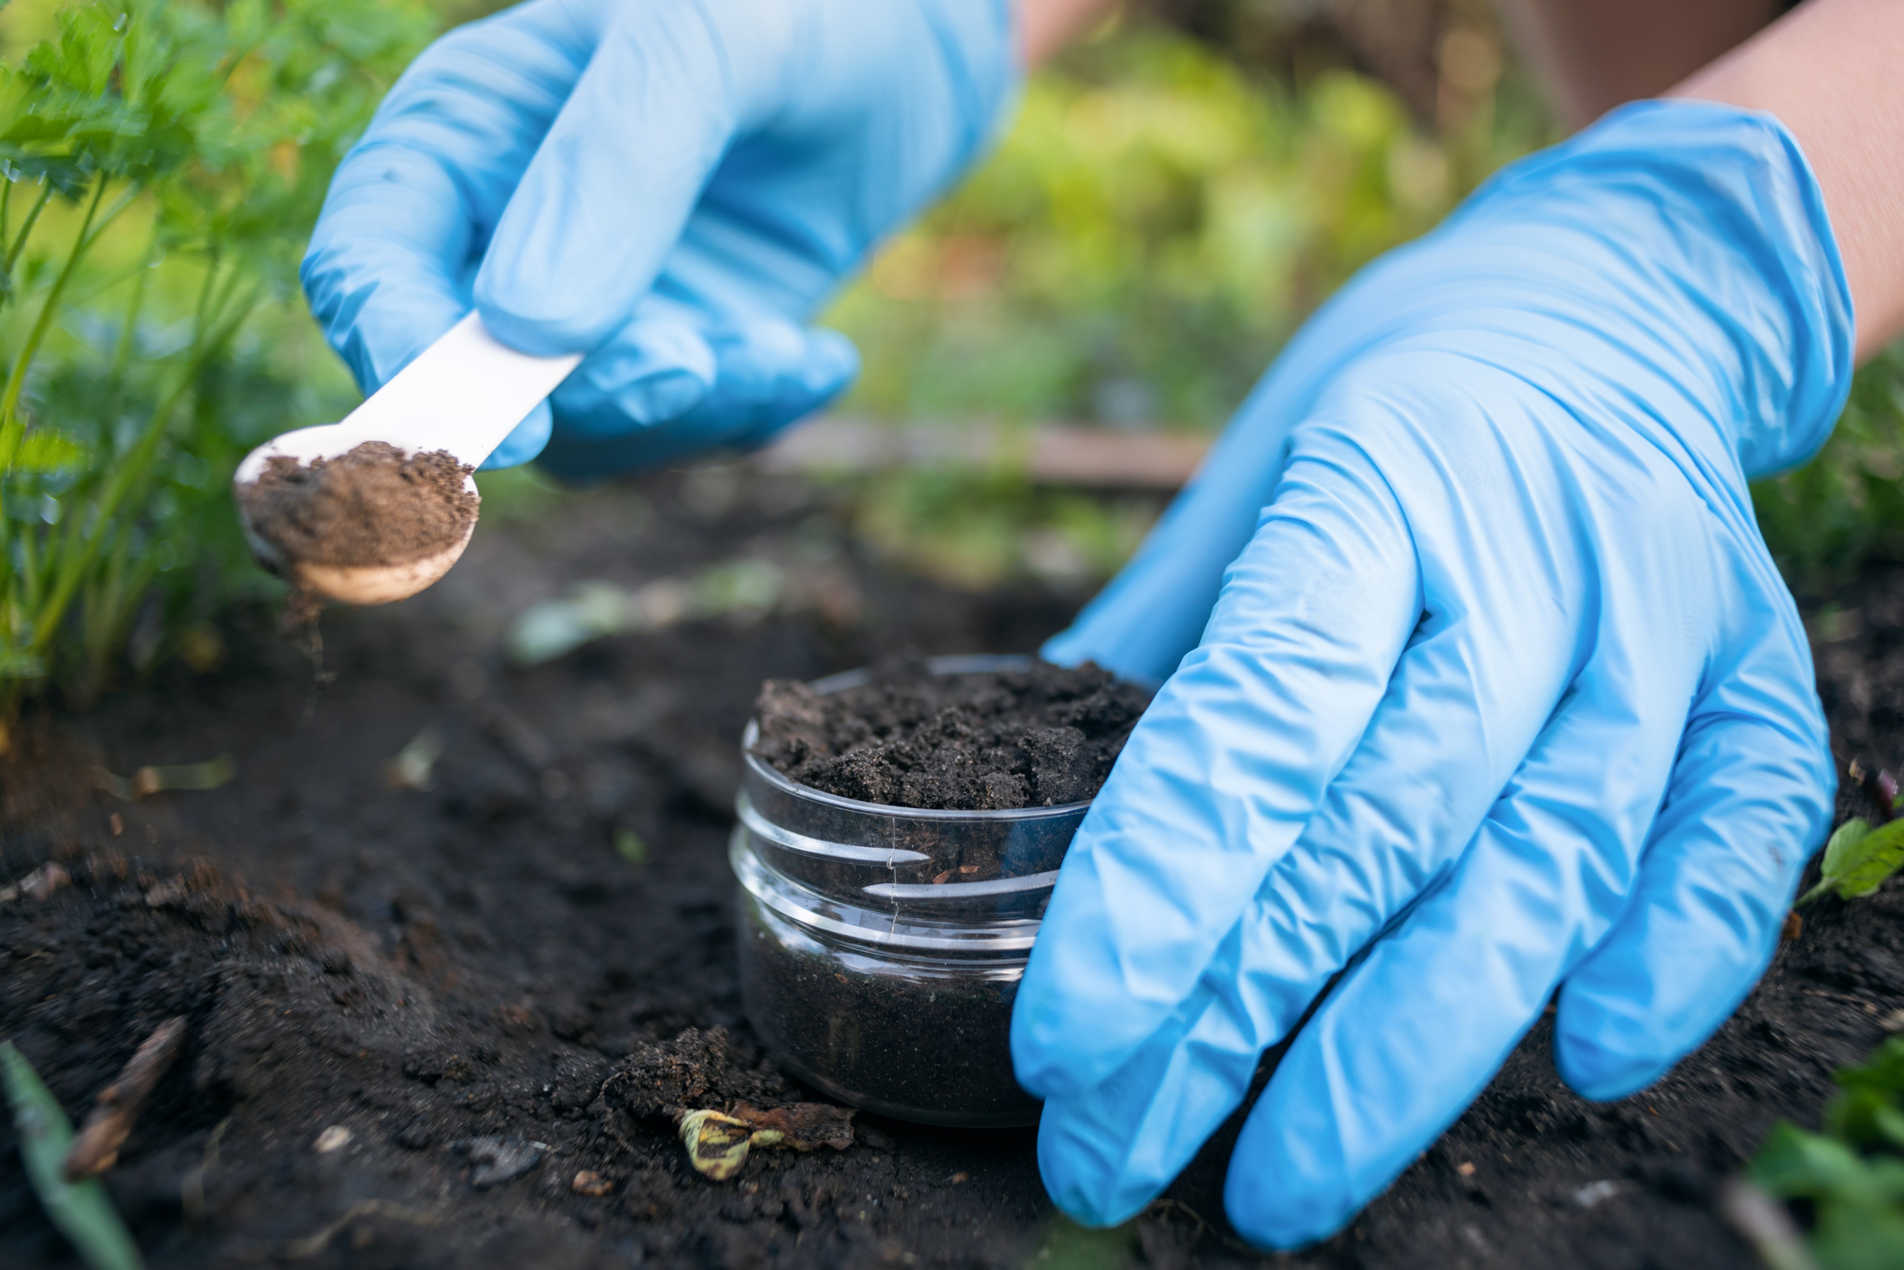
PROJECT FACTS
Title: MIBIREM – Innovative Toolbox for Microbiome-based Soil Remediation
Funding programme:
European Union‘s Horizon Europe
Funding Agency: EUROPEAN RESEARCH EXECUTIVE AGENCY (REA)
EU contribution: EUR € 6 Mio.
Start: 1 October 2022
End: 31 March 2027
Duration: 4,5 years
11 partners from EU 6 countries

Slide 3
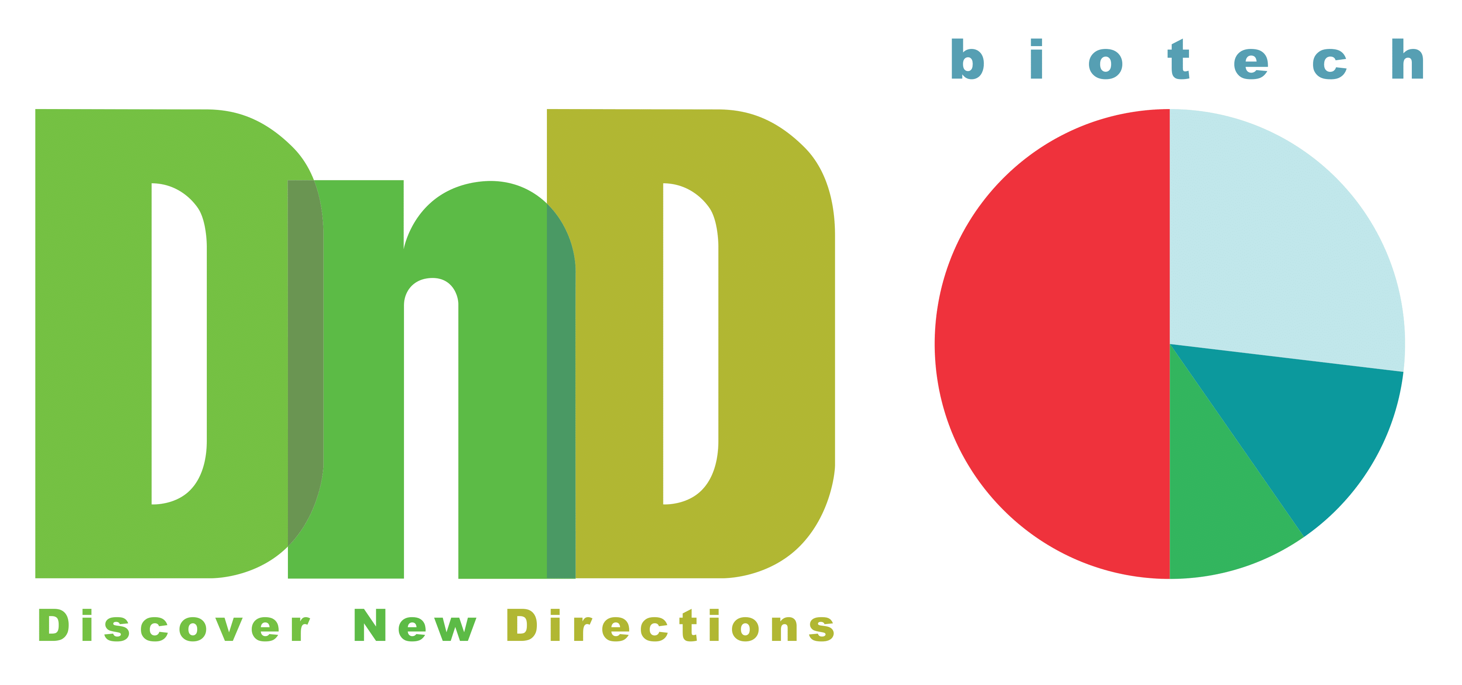
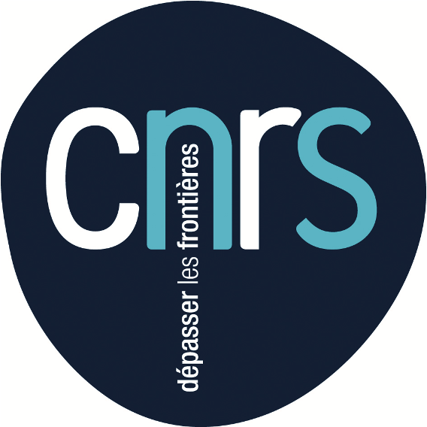
PROJECT CONSORTIUM
MIBIREM is coordinated by the RTDS Group (Austria).
The Scientific Coordinator is Thomas Reichenauer, Senior Scientist at the Competence Unit Bioresources of the AIT Austrian Institute of Technology.

Slide 4
MIBIREM SUMMARY
Contaminated sites pose a significant risk to humans and the environment.
Innovative cleaning technologies are needed to remediate these sites and remove contaminants from the environment.
Bioremediation uses living organisms, mostly microbes and bacteria, to get rid of environmental contaminants. Microbiomes can produce enzymes that degrade organic contaminants in soil and groundwater.
The EU-funded MIBIREM project will leverage the potential of microbiomes for bioremediation of contaminated sites. MIBIREM will develop a unique and innovative technological toolbox for microbiome-based bioremediation to clean up contaminated sites across Europe.

Slide 5
PROJECT CHALLENGE
In Europe, there are currently 324,000 severely contaminated sites, such as mines, landfills or petrol stations.
Many organic contaminants in are difficult to remove: can reach deep into the soil, are extensive, or the contamination is below a used building.
Conventional remediation technologies to clean up these sites are often too costly, technically demanding and not eco-friendly.
With the MIBIREM toolbox, the project will identify, analyse, cultivate and upscale microbiomes for bioremediation, to take up the challenge of cleaning up Europe’s contaminated sites.

Slide 6
PROJECT SOLUTIONS
Microbiomes have high potential to improve remediation processes as
more cost-effective
eco-friendly: use little water, do not produce waste & have a low carbon footprint.
The MIBIREM toolbox provides innovative methods in using the potential of microbiomes in degrading contaminants in soil.
MIBIREM develops molecular methods for the monitoring, isolation, cultivation and subsequent deposition of whole microbiomes.
Long-term upscaling of microbiome-based bioremediation will benefit
humans and the environment.

Slide 7
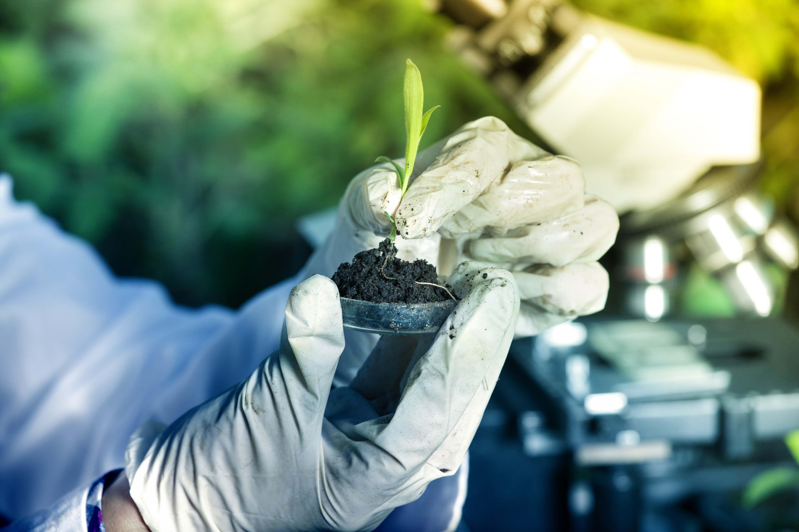
EXPECTED IMPACTS
Bioremediation is 20-50% cheaper than current practice
Bioremediation emits 70-90% less CO2 emissions than conventional remediation technologies
The bioremediation market has huge potential, growing 105% faster than the conventional remediation market
20,000-26,000 sites in Europe are suitable for immediate bioremediation
A projected yearly increase of 3-5% of MIBIREM-based bioremediation

Slide 8
THANK YOU!
Name:
Affiliation:
E-Mail:
Links: https://twitter.com/mibirem
https://www.linkedin.com/company/mibirem
MIBIREM contacts:
For general enquiries: mibirem@rtds-group.com
Scientific Coordinator contact: thomas.reichenauer@ait.ac.at
Project coordinator: Stephen Webb, RTDS
This project received funding of the EUROPEAN RESEARCH EXECUTIVE AGENCY (REA)
under the European Union’s Horizon Europe Programme of grant number GA 101059260

